Slide 1
These slides are provided for educational purposes as of May 1, 2024
Note:
These slides are made available to any appropriately requesting individual, regardless of the manner in which they cover, recommend, or participate in the ordering of any Exact Sciences product.
Individuals may use these slides for scientific or educational purposes only.
Exact Sciences does not grant permission to modify the slides or their content and therefore is not responsible for any edits or changes made by a user. This includes, but not limited to, edits or changes to the contents, order, format, and/or incorporation or adoption of these slides or their content into other materials.
The information on these slides may not constitute the most up-to-date data information or data. It is the user’s responsibility to verify the accuracy of these slides for the desired use to comply with applicable rules, laws, or regulations (e.g., event organizer or accrediting body standards/requirements, copyright laws, institutional requirements, etc.).
These slides and their contents are provided: (1) with any faults AS IS AND AS AVAILABLE; and (2) without any assurance, warranty, condition, or duty of or regarding the slides and/or their contents: accuracy, availability, adequacy, validity, reliability, completeness, performance, or compatibility. Exact Sciences disclaims any liability associated with the use of these slides.
© 2024 Exact Sciences Corporation. All rights reserved.

Slide 2
Estimated* Liver Cancer Incidence and Mortality, US 2024
13th most common cause of cancer in the US and the 6th leading cause of cancer-related deaths in the US
Estimated* Incidence of the Top Cancers in the US (2024)
Estimated* Mortality of the Top Cancers in the US (2024)
NOTE: These are model-based estimates that should be interpreted with caution and not compared with those for previous years
*Estimates are rounded to the nearest 10, and cases exclude basal cell and squamous cell skin cancers and in situ carcinoma except urinary bladder. Ranking is based on modeled projections and may differ from the most recent observed data.
Siegel RL, et al. CA Cancer J Clin. 2024;74:12-49.

Slide 3
Liver Cancer
One of the fastest growing causes of cancer-related deaths in the US¹
Projected to be the third leading cause of cancer-related deaths by 2040²
Estimated* & New Cases/Deaths²
5-Year Survival for Liver & Intrahepatic Bile Duct^{3†}
NEW CASES
DEATHS
*NOTE: These are model-based estimates that should be interpreted with caution and not compared with those for previous years. Source: Estimated new cases are based on 2004-2018 incidence data reported by the North American Association of Central Cancer Registries (NAACCR). Estimated deaths are based on 2005-2019 US mortality data, National Center for Health Statistics, Centers for Disease Control and Prevention. Estimates are rounded to the nearest 10; cases exclude basal cell and squamous cell skin cancers and in situ carcinoma except urinary bladder. The 2022 projections are based on currently available incidence and mortality and do not reflet the impact of COVID-19 on cancer cases and death.
†Five‐year relative survival for selected cancers by race and stage at diagnosis, United States, 2013–2019. All patients were followed through 2020.
1. Cronin, KA, et al. Cancer. 2022;128(24):4251-4284. 2. Rahib L, et al. JAMA Netw Open. 2021;4(4):e214708 3. Siegel RL, et al. CA Cancer J Clin. 2024;74:12-49. a

Slide 4
Hepatocellular Carcinoma
75% - 85% of liver cancer is HCC¹
HCC develops from hepatocytes and hepatic progenitor cells²
HCC occurs almost exclusively in the presence of cirrhosis¹
Results from liver injury due to inflammation, fibrosis, and aberrant regeneration³
1. Singal AG, et al. J Hepatol. 2020;72(2):250-261. 2. Sia D, et al. Gastroenterol. 2017;152(4):745-761. 3. Villanueva A. N Engl J Med. 2019;380(15):1450-1462.

Slide 5
Clinical Development Program
Patients at Risk for HCC^{1,2}
Incidence of HCC by Risk Group¹
With Cirrhosis
  Hepatitis B
  Hepatitis C
  Alcohol
  NAFLD
  Hereditary hemochromatosis
  Primary biliary cholangitis
  Alpha-1-antitrypsin deficiency
  Other causes of cirrhosis
Without cirrhosis
  Hepatitis B
Population | Incidence of HCC
Asian male hepatitis B carriers over age 40 | 0.4% to 0.6% per year
Asian female hepatitis B carriers over age 50 | 0.3% to 0.6% per year
Hepatitis B carriers with family history of HCC | Incidence higher than without a family history
African and/or North American Black individuals with hepatitis B | HCC occurs at a younger age
Hepatitis B carriers with cirrhosis | 3% to 8% per year
Hepatitis C cirrhosis | 3% to 5% per year
Stage 4 primary biliary cholangitis | 3% to 5% per year
Genetic hemochromatosis and cirrhosis | Unknown, but probably >1.5%
Alpha-1 antitrypsin deficiency and cirrhosis | Unknown, but probably >1.5%
Other cirrhosis | Unknown
It is recommended that patients with cirrhosis or chronic hepatitis B viral infection enroll
in an HCC surveillance program¹
HCC: Hepatocellular carcinoma, NAFLD: Non-alcoholic fatty liver disease
1. Marrero, et al. Hepatol. 2018;68:723-750. 2. Llovet JM, et al. Nat Rev Dis Primers. 2021;7(1):6.

Slide 6
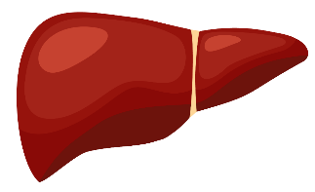
Survival Time Based on Stage of Detection
2 3
HCC cases are detected
in late stage.¹⁻³
of
Very early stage (0)
Early stage (A)
Intermediate stage (B)
Advanced stage (C)
Terminal stage (D)
>5 years
>2 years
8-13 months
3 months
ESTIMATED SURVIVAL TIME
BCLC: Barcelona Clinic Liver Cancer; HCC: hepatocellular carcinoma
1. Villanueva A. N Engl J Med. 2019;380(15):1450-1462. 2. Choi DT, et al. Clin Gastroenterol Hepatol. 2019;17(5):976-987.e4. 3. Singal AG, et al. J Hepatol. 2020;72(2):250-261

Slide 7
Goals of Surveillance
HCC surveillance is associated with:¹
Early detection of tumors
Receipt of curative treatment
Improved survival
<1/4 of patients receive the recommended HCC surveillance²
HCC: Hepatocellular carcinoma
1. Villanueva A. N Engl J Med. 2019;380(15):1450-1462. 2. Wolf E, et al. J Hepatol. 2021;73(2):713-725.

Slide 8
Surveillance Guidelines
AASLD 2018^{1,2} | AASLD 2018
Population | Cirrhosis HBV (selected)
Tests | U/S ± AFP
Interval | 6 months*
*Recommended interval if no concerning lesion is detected on ultrasound
AASLD: American Association for the Study of Liver Diseases; AFP: Alpha-fetoprotein; HBV: Hepatitis B Virus; U/S: Ultrasound.
1. Marrero JA, et al. Hepatol. 2018;68:723-750. 2. Heimbach JK, et al. Hepatol. 2018;67(1):358-380.

Slide 9
Test Performance for Surveillance Methods
Standard of Care tests provide poor sensitivity for early-stage disease¹
Sensitivity
(early-stage)
Sensitivity
(any stage)
Specificity
U/S¹
45%
78%
92%
AFP²
31%
46%
98%
U/S + AFP¹
63%
97%
84%
*Cut-off value corresponds to matching mt-HBT specificity of 88%.
AFP: Alpha-fetoprotein; AFP-L3: Lens culinaris agglutinin-reactive AFP; DCP: des-γ-carboxy-prothrombin; GALAD: gender, age, AFP-L3, AFP, and DCP; mt-HBT: multi-target Hepatocellular carcinoma Blood Test; U/S: Ultrasound.
1. Tzartzeva K, et al. Gastroenterol. 2018;154(6):1706-1718.e1. 2. Chalasani NP, et al. Clin Gastroenterol Hepatol. 2022;20:173-182.

Slide 10
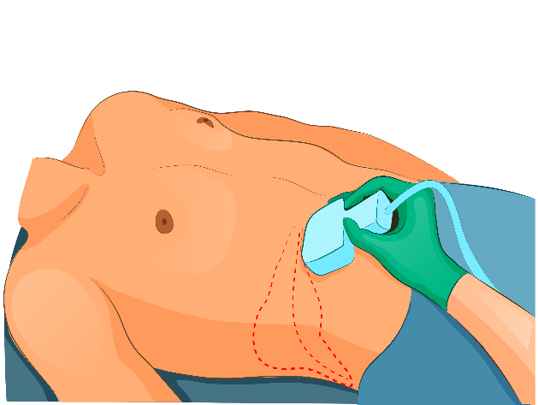
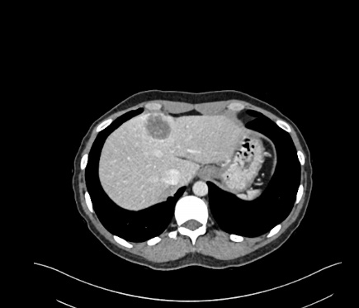
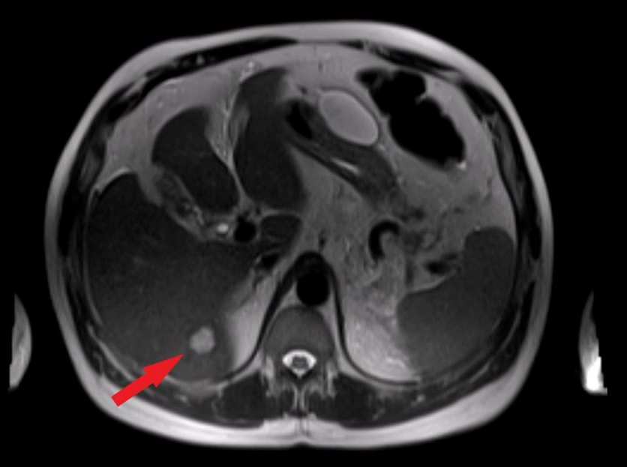
Current Surveillance Methods
Ultrasound^{1,2}
Readily available
Safe/minimal direct physical harms
Limited sensitivity
Limited performance in certain patient groups
  Abdominal obesity
  Echogenic liver (alcoholic, nonalcoholic fatty liver disease)
  Severe ascites
Operator-dependent test
CT and MRI²
MRI may have higher sensitivity than ultrasound
Cost may be a concern
Limited capacity/access
Radiation and contrast exposure
Source: ShutterStock.com
Source: ShutterStock.com
Source: ShutterStock.com
CT: Computed tomography; MRI: Magnetic resonance imaging.
1. Yang JD, et al. Semin Liver Dis. 2019;39(4):452-462. 2. Singal AG, et al. J Hepatol. 2020;72(2):250-261..

Slide 11
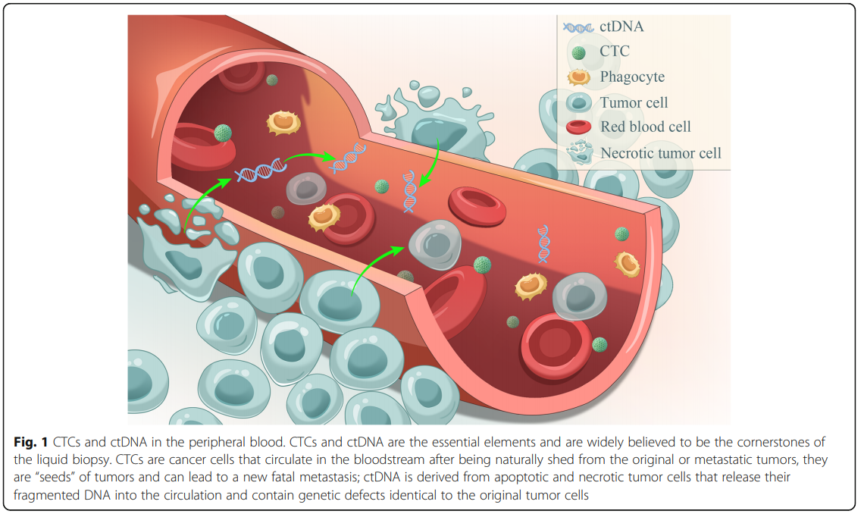
Circulating Tumor DNA (ctDNA) for HCC Surveillance
Cell-free DNA (cfDNA)¹
Fragmented DNA in the blood of healthy individuals and patients with or without cancer
Shed from normal turnover of lymphoid and myeloid cells
CTCs and ctDNA in the Peripheral Blood³
ctDNA¹⁻³
Tumor-specific component of circulating cfDNA
Released by necrotic or apoptotic tumor cells
ctDNA amount in the blood is very low (<1% of total cfDNA)
Harbor molecular characteristics present in genomic DNA of cancers
  Methylation changes
  Point mutations
Ye et al. Molecular Cancer. 2019;18(1):114. Figure distributed under the terms of the
Creative Commons Attribution 4.0 International License.
CTCs: Circulating Tumor Cells; HCC: Hepatocellular carcinoma.
1. Yang JD, et al. Semin Liver Dis. 2019 Nov;39(4):452-462. 2. Tran, et al. JHEP Rep. 2021;3(4):100304. 3. Ye, et al. Mol Cancer. 2019;18(1):114.

Slide 12
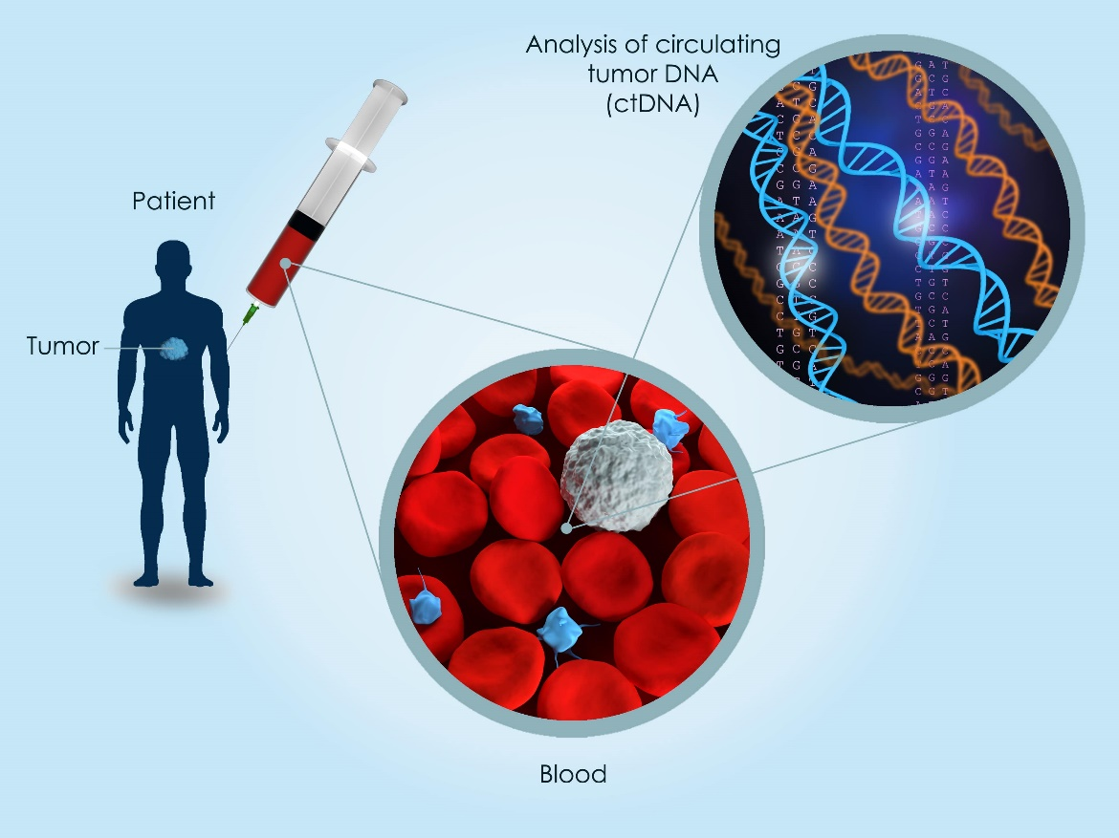
Liquid Biopsy (Blood-based Biomarkers)
Circulating tumor DNA (ctDNA) released into the bloodstream provides a minimally invasive approach for early HCC detection¹
DETECTION AND QUANTIFICATION OF ctDNA
IN PERIPHERAL BLOOD
Blood-based biomarkers may provide:¹⁻³
High sensitivity and specificity for early detection
Prediction of treatment
Prognostic outcomes¹
Liquid Biopsy
ctDNA Components
Point mutations
Translocations
Deletions/Insertions
DNA Methylation
Amplification
Chromosome aberrations
Tumor Components
Including circulating nucleic
acids, tumor cells, proteins
are released by tumors into
the blood stream.
Source: ShutterStock.com
HCC: Hepatocellular carcinoma.
1. Yang JD, et al. Semin Liver Dis. 2019;39(4):452-462. 2. Tran, et al. JHEP Rep. 2021;3(4):100304. 3. Ye, et al. Mol Cancer. 2019 Jul 3;18(1):114. ​

Slide 13
Clinical Development Program
Marker Discovery and Biological Validation
(Kisiel et al. 2019)
Marker Selection
(Chalasani et al. 2020)
Algorithm Development
(Chalasani et al. 2021)
Objective: Identify promising biomarkers
Experiments: Discovery and technical validation, biological validation, Phase I and II plasma studies
Objective: Assess performance of candidate biomarkers
Study Cohort: 135 HCC cases and 302 controls
Objective: Validate test performance in independent cohort
Study Cohort: 156 HCC cases and 245 controls
Clinical Validation
(Chalasani et al. 2021)
Objective: Finalize biomarker panel, develop, and lock algorithm
Study Cohort: 135 HCC cases and 404 controls
HCC: Hepatocellular carcinoma.
1. Kisiel JB, et al. Hepatol. 2019;69(3):1180-1192. 2. Chalasani NP, et al. Clin Gastroenterol Hepatol. 2021;19:2597-2605. 3. Chalasani NP, et al. Clin Gastroenterol Hepatol. 2022;20:173-182.

Slide 14
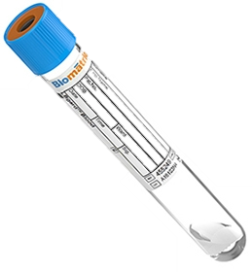
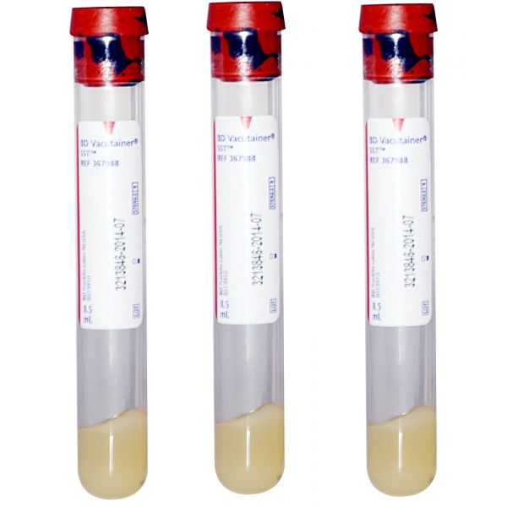

mt-HBT: Workflow
Methylated DNA Marker Analysis (HOXA1, TSPYL5, B3GALT6)
1
2
3
4
Blood Collection
Centrifugation
Algorithm
Composite Score
NEGATIVE
<0.2255
HIGH
≥0.2255
or Invalid
cfDNA Extraction
Bisulfite Conversion
Methylated DNA Marker Detection
+
Plasma for
Methylated DNA Marker Analysis
AFP Analysis
-
3
3 -LBgard® tubes
Methylated DNA Marker analysis
SST® tube
AFP analysis
Serum for AFP Analysis
Patient Sex at Birth
3
AFP: Alpha-fetoprotein; B3GALT6: beta-1,3-galactosyltransferase 6; cfDNA: cell-free DNA; HOXA1: homeobox A1; mt-HBT: multi-target Hepatocellular carcinoma Blood Test; TSPYL5: Testis specific protein Y-linked like 5.
Chalasani NP, et al. Clin Gastroenterol Hepatol. 2022:20:173-182.

Slide 15
Development and Validation - Demographic and Tumor Characteristics
Clinical validation study of mt-HBT testing by Chalasani, et al. 2022 in 156 HCC cases and 245 controls
*Other: includes autoimmune hepatitis, genetic hemochromatosis, stage 4 primary biliary cholangitis, primary sclerosing cholangitis, and cryptogenic cirrhosis.
ASH: alcoholic steatohepatitis; HBV: hepatitis B virus; HCC: Hepatocellular carcinoma; HCV: hepatitis C virus; NAFLD: Nonalcoholic fatty liver disease; BCLC: Barcelona Clinic Liver Cancer.
Chalasani NP, et al. Clin Gastroenterol Hepatol. 2022:20:173-182.

Slide 16
Clinical Validation - Test Performance Select Subgroups
Subgroup (n)* | Sensitivity, % (95% CI) | mt-sDNA (n=9,989) |  | Overall Sensitivity, % (95% CI) | Specificity, % (95% CI)
 | BCLC Stage 0 + A | BCLC Stage B + C | Milan Criteria
Sex
Male (274) | 83 (72, 90) | 94 (85, 98) | 82 (70, 90) | 89 (82, 93) | 84 (77, 89)
Female (127) | 77 (50, 92) | 92 (67, 99) | 75 (47, 91) | 85 (67, 94) | 91 (84, 95)
Viral Status†
Viral (222) | 84 (71, 92) | 96 (87, 99) | 85 (70, 93) | 91 (83, 95) | 90 (83, 94)
Non-viral (164) | 80 (63, 91) | 92 (75, 98) | 77 (58, 89) | 86 (74, 92) | 84 (76, 90)
BMI‡
<30 (229) | 85 (72, 93) | 96 (86, 99) | 86 (73, 94) | 90 (83, 95) | 87 (80, 91)
≥30 (160) | 77 (59, 88) | 92 (76, 98) | 71 (51, 85) | 84 (72, 91) | 88 (80, 93)
Child-Pugh class§
Class A (273) | 81 (68, 89) | 93 (82, 97) | 80 (66, 89) | 87 (79, 92) | 88 (82, 92)
Class B (96) | 81 (60, 92) | 96 (78, 99) | 79 (57, 92) | 88 (76, 95) | 83 (71, 91)
Cirrhosis Status
Cirrhosis (377) | 83 (73, 90) | 93 (85, 97) | 81 (70, 88) | 88 (82, 92) | 87 (82, 91)
*Total number of participants within each subgroup (both HCC and control subjects)
†Viral status was unknown for 6 HCC (1 BCLC stage 0, 2 BCLC stage A, 1 BCLC stage B, and 1 BCLC stage C) and 9 control subjects
‡BMI data were missing for 6 HCC (1 BCLC stage A, 1 BCLC stage B, and 4 BCLC stage C) and 6 control subjects
§Child-Pugh data were missing for 8 HCC (1 BCLC stage 0, 4 BCLC stage A, and 3 BCLC stage C) and 24 control subjects
BCLC: Barcelona Clinic Liver Cancer, BMI: Body Mass Index, CI: Confidence Interval, HCC: Hepatocellular carcinoma.
Chalasani NP, et al. Clin Gastroenterol Hepatol. 2022:20:173-182.

Slide 17
Clinical Validation - Test Performance
 | Sensitivity, % (95% CI) | mt-sDNA (n=9,989) |  | Overall Sensitivity, % (95% CI) (n=156) | Specificity, % (95% CI) (n=245)
 | BCLC Stage 0 + A (n=78) | BCLC Stage B + C (n=78) | Milan Criteria (n=68)
mt-HBT | 82 (72, 89) | 94 (86, 97) | 81 (70, 88) | 88 (82, 92) | 87 (82, 91)
AFP (≥20 ng/mL) | 40 (30, 51) | 77 (66, 85) | 41 (30, 53) | 58 (51, 66) | 100 (98, 100)
GALAD (≥-0.63) | 71 (60, 79) | 91 (83, 96) | 71 (60, 80) | 81 (74, 86) | 93 (90, 96)
GALAD (≥-1.18*) | 78 (68, 86) | 92 (84, 96) | 78 (67, 86) | 85 (79, 90) | 87 (82, 91)
*Cutoff value corresponds to matching to mt-HBT specificity of 87%.
AFP: Alpha-fetoprotein; BCLC: Barcelona Clinic Liver Cancer; CI: confidence interval; GALAD: Gender, Age, AFP-L3, AFP, and DCP model; mt-HBT: multi-target Hepatocellular carcinoma Blood Test.
Chalasani NP, et al. Clin Gastroenterol Hepatol. 2022:20:173-182.

Slide 18
Result Interpretation
mt-HBT identifies individuals with higher vs lower chances of HCC
Negative mt-HBT Result
~0.3% Chance of HCC*
Continue schedule of
surveillance testing
Hypothetical HCC
Surveillance Candidate
High-risk individual
2% Chance of HCC*
High mt-HBT Result
~12% Chance of HCC*
Consider confirmatory
testing—i.e., CT or MRI
*To calculate the chance of HCC after a positive or negative test result, this hypothetical example assumes a 2% HCC prevalence, test sensitivity of 88%, and test specificity of 87%. Sensitivity and specificity statistics reported in Chalasani NP, et al. Clin Gastroenterol Hepatol. 2022:20:173-182.
HCC: Hepatocellular carcinoma; mt-HBT: multi-target Hepatocellular carcinoma Blood Test.

Slide 19
Oncoguard® Liver Test (mt-HBT) – Intended Use
The Oncoguard Liver test is a blood-based test for the qualitative detection of biomarkers associated with hepatocellular carcinoma in serum and plasma derived from whole blood.
The test is intended as an aid in the detection of hepatocellular carcinoma for adults with liver cirrhosis and/or chronic hepatitis B (HBV) who are at risk for hepatocellular carcinoma.
The Oncoguard Liver test was validated in patients at risk for hepatocellular carcinoma, including those with cirrhosis and/or chronic HBV.
Disclaimer: The Oncoguard Liver test was developed, and the performance characteristics validated by Genomic Health, Inc., a wholly owned subsidiary of Exact Sciences Corporation following College of American Pathologists (CAP) and Clinical Laboratory Improvement Amendments (CLIA) regulations. The Oncoguard Liver test is performed at the Genomic Health Redwood City clinical laboratory. Exact Sciences clinical laboratories are accredited by CAP, certified under CLIA regulations, and qualified to perform high-complexity clinical laboratory testing. This test has not been cleared or approved by the US Food and Drug Administration or other notified regulatory authority.
HCV: hepatitis C virus; mt-HBT: multi-target-Hepatocellular carcinoma Blood Test; NAFLD: Nonalcoholic fatty liver disease; NASH: Non-alcoholic steatohepatitis.
Exact Sciences Corporation. Oncoguard Liver Provider FAQs. Revised May 2022. Accessed May 1, 2024. https://www.oncoguardliver.com/providers/faq

Slide 20
Summary
Early-detection of HCC may improve patient outcomes¹
Circulating tumor DNA (ctDNA) in the blood provides a minimally invasive approach for early HCC detection²
The mt-HBT test is a blood-based test for HCC detection³
Clinical validation results showed:³
  Early-stage sensitivity of 82%
  Overall sensitivity of 88%
  Specificity of 87%
HCC: Hepatocellular carcinoma; mt-HBT: multi-target Hepatocellular carcinoma Blood Test.
1. Villanueva A. N Engl J Med. 2019;380(15):1450-1462. 2.Yang JD, et al. Semin Liver Dis. 2019;39(4):452-462. 3. Chalasani NP, et al. Clin Gastroenterol Hepatol. 2022:20:173-182.

Slide 21
These slides are provided for educational purposes as of May 1, 2024
Note:
These slides are made available to any appropriately requesting individual, regardless of the manner in which they cover, recommend, or participate in the ordering of any Exact Sciences product.
Individuals may use these slides for scientific or educational purposes only.
Exact Sciences does not grant permission to modify the slides or their content and therefore is not responsible for any edits or changes made by a user. This includes, but not limited to, edits or changes to the contents, order, format, and/or incorporation or adoption of these slides or their content into other materials.
The information on these slides may not constitute the most up-to-date data information or data. It is the user’s responsibility to verify the accuracy of these slides for the desired use to comply with applicable rules, laws, or regulations (e.g., event organizer or accrediting body standards/requirements, copyright laws, institutional requirements, etc.).
These slides and their contents are provided: (1) with any faults AS IS AND AS AVAILABLE; and (2) without any assurance, warranty, condition, or duty of or regarding the slides and/or their contents: accuracy, availability, adequacy, validity, reliability, completeness, performance, or compatibility. Exact Sciences disclaims any liability associated with the use of these slides.
© 2024 Exact Sciences Corporation. All rights reserved.

