Slide 1
These slides are provided for educational purposes as of April 18, 2024
Note:
These slides are made available to any appropriately requesting individual, regardless of the manner in which they cover, recommend, or participate in the ordering of any Exact Sciences product.
Individuals may use these slides for scientific or educational purposes only.
Exact Sciences does not grant permission to modify the slides or their content and therefore is not responsible for any edits or changes made by a user. This includes, but not limited to, edits or changes to the contents, order, format, and/or incorporation or adoption of these slides or their content into other materials.
The information on these slides may not constitute the most up-to-date data information or data. It is the user’s responsibility to verify the accuracy of these slides for the desired use to comply with applicable rules, laws, or regulations (e.g., event organizer or accrediting body standards/requirements, copyright laws, institutional requirements, etc.).
These slides and their contents are provided: (1) with any faults AS IS AND AS AVAILABLE; and (2) without any assurance, warranty, condition, or duty of or regarding the slides and/or their contents: accuracy, availability, adequacy, validity, reliability, completeness, performance, or compatibility. Exact Sciences disclaims any liability associated with the use of these slides.
© 2024 Exact Sciences Corporation All rights reserved.

Slide 2
Multi-Cancer Early Detection Through Multiple Analyte Testing
04.18.2024 / MED-CAG-2200134 (v6.0)

Slide 3
Disclaimer
This presentation contains information for a technology under development and has not been cleared or approved by the Food and Drug Administration or any other national regulatory authority. The features describe current development goals, and claims have yet to be established.

Slide 4
Many Challenges Exist in Cancer Care
2024 estimates
Cancer remains the 2nd leading cause of death in the US
Over 2 million
~612,000
Disparities‡
new cancer cases*
cancer deaths†
persist in cancer
*These are model-based estimates that should be interpreted with caution and not compared with those for previous years..
†Cancer disparities are differences in cancer occurrence and outcomes according to sociodemographic factors, such as race, ethnicity, age, sexual orientation, or where you live.
Siegel RL, et al. CA Cancer J Clin. 2024;74(1):12-49.

Slide 5
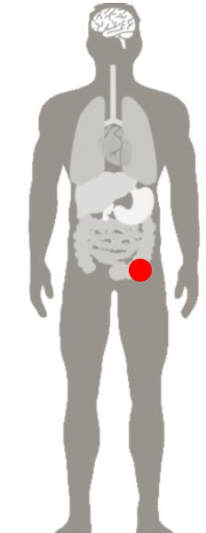
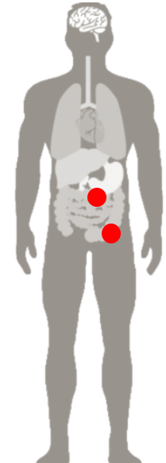
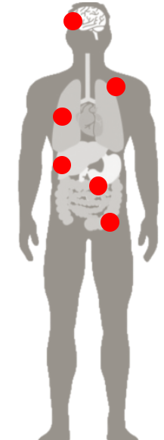
Earlier Detection is Associated with Longer Survival
Example: Colorectal Cancer*
LOCAL
Stage I, IIa, IIb
REGIONAL
Stage IIc, III
DISTANT METASTASIS
Stage IV
~91%
~73%
~14%
5-Year Survival
POST-DIAGNOSIS
5-Year Survival
POST-DIAGNOSIS
5-Year Survival
POST-DIAGNOSIS
*Five-year relative survival based on stage at diagnosis, United States, 2013-2019. All patients were followed through 2020.
Siegel RL, et al. CA Cancer J Clin. 2024;74(1):12-49.

Slide 6
Diagnosis at More Advanced Stages is Associated with Lower Probability of Long-term Survival¹
Average 5-year Survival Rate by Stage at Diagnosis^{1*}
 | 0% | 20% | 40% | 60% | 80% | 100%
Pancreas
Ovary
Uterine cervix
Colorectum
Non-Hodgkin lymphoma
Urinary bladder†
Lung and bronchus
Esophageal
Liver and bile duct
Distant metastases (late stage)
Regional metastases
Localized tumors (early stage)
If cancer cells have penetrated beyond the original layer of tissue, the cancer has become invasive and is categorized as local, regional, or distant based on the extent of spread.²
*Five-year relative survival, United States, 2013-2019. All patients were followed through 2020.
†The survival rate for patients with carcinoma in situ of the urinary bladder is 96%.
1. Siegel RL, et al. CA Cancer J Clin. 2024;74(1):12-49. 2. ACS. Cancer facts and figures 2024. Atlanta: American Cancer Society, 2024.
.

Slide 7
Current Cancer Screening Guidelines
Cancer | Population | Age at First Screening (years) | Screening Modality |  | Interval
Lung^{1,2} | High-risk | 50 if high-risk criteria are met | Low-dose CT |  | Every 1 year
Breast^{1,4} | Average-risk | 40 | Mammogram, Ultrasound, MRI |  | Every 1-2 years
Colorectal^{1,4} | Average-risk | 45 and older | Stool-based methods FIT mt-sDNA HS-gFOBT | Direct visualization CT colonography Colonoscopy Flexible sigmoidoscopy | 1-10 years, depending on test
Cervical^{1,5} | Average-risk | 21, 25 | Pap test, HPV test |  | 3-5 years
Prostate^{1,6} | Individual basis | 45-50, 55-69 | PSA |  | No recommendation
CT: computed tomography; FIT: fecal immunochemical test; HPV: human papillomavirus; HS-gFOBT: high-sensitivity guaiac-based fecal occult blood test; MRI: magnetic resonance imaging; mt-sDNA: multi-target stool DNA test; PSA: prostate-specific antigen; USPSTF: US Preventive Services Task Force.
1. ACS. ACS guidelines for the early detection of cancer. Updated November 1, 2023. Accessed March 28, 2024. https://www.cancer.org/healthy/find-cancer-early/american-cancer-society-guidelines-for-the-early-detection-of-cancer.html 2. Krist AH, et al. JAMA. 2021;325(10):962-970. 3. Siu AL, et al. Ann Intern Med. 2016;164(4):279-296. 4. Davidson KW, et al. JAMA. 2021;325(19):1965-1977. 5. Curry SJ, et al. JAMA. 2018;320(7):674-686. 6. Grossman DC, et al. JAMA. 2018;319(18):1901-1913.

Slide 8
Single Cancer Screening Test Performance Varies
 | Mammography^{1,3-7} | CRC Screening⁸⁻¹¹ | Lung Cancer Screening¹²⁻¹³
Population | Women aged 50-74 | Age 45-75, average risk | Age 55-74 with a history of at least 30 pack-years of smoking
Targeted Cancers | Breast, female | Colorectal | Lung
Estimate % of All Cancer Deaths² | 7.1% | 8.6% | 20.8%
Sensitivity | 77% - 95% | 92.3%* | 84.9%‡
Specificity | 94%- 97% | 86.6%*, 95.2%† | 87.2%‡
Positive Predictive Value | 2.0% - 22.0% | 3.7%* | 6.9%
Adherence With Recommended Screening | 61.4%⁴ | 74.2% (all modalities) | 55.0%¹⁴
False Positive Rate | 61.3% | 10.2-%13.4%* | 12.8%§
*mt-sDNA in patients 50-84 years of age; †mt-sDNA in patients 50-75 years of age; ‡ Lung-RADS test; § low dose CT
1.United States Preventive Services Task Force. Screening for breast cancer: Ann Intern Med. 2009;151(10):716-26, W-236. 2. SEER Cancer Stat Facts. 2023. Accessed March 28,2024. https://seer.cancer.gov/statfacts/index.html. 3. Humphrey LL, et al. Ann Intern Med. 2002;137:347-60. 4. Dennis LK, et al. Cancers. 2021;13:5918. 5.Hubbard RA, et al. Ann Intern Med. 2011;155(8):481-92. 6. Lehman CD, et al. Radiology. 2017; 283-49-58. 7. Siu AL, et al. Ann Intern Med. 2016;164(4):279-296. 8. Imperiale TF, et al. N Engl J Med. 2014;370(14):1287-1297. 9. Imperiale TF, et al. Cancer Prev Res. 2021;(suppl 1):1-4. 10. CDC. BRFSS prevalence & trends data. 2020. Accessed March 28, 2024. https://nccd.cdc.gov/BRFSSPrevalence/rdPage.aspx?rdReport=DPH_BRFSS.ExploreByTopic&irbLocationType=StatesAndMMSA&islClass=CLASS04&islTopic=TOPIC52&islYear=2018&rdRnd=47539 11. Imperiale TF, et al. N Engl J. Med. 2014;370(suppl1):1-10,s2-s3. 12. National Lung Screening Trial Research Team. N Engl J Med. 2013;368(21):1980-1991. 13. Pinsky PF, et al. Ann Intern Med. 2015;162:485-91. 14. Lopez-Olivo MA, et al. JAMA Netw Open 2020;3(11):e2025102-e2025102.

Slide 9












People Experience Multiple Barriers to Screening
Awareness
Personal
Socioeconomic
Poor knowledge of risks or value of screening^{1,2}
Pain or discomfort in procedure^{1,2}
Lack of Transportation^{2,3}
Lack of provider recommendation¹⁻³
Fear or worry of results^{1,3}
Costs due to lack of income or insurance^{2,3}
Low priority and delay in scheduling³
Discrimination
(age, disability, race and income)⁴
Low literacy or language barriers^{1,2}
1. Gesink D, et al. Cancer Epidemiol. 2016;45:126-134. 2. Alexandraki I, Mooradian AD. J Natl Med Assoc. 2010;102(3):206-218. 3. Muthukrishnan M, et al. Prev Med Rep. 2019;15:100896. 4. ACS website. Cancer disparities ACS research highlights. Accessed March 28, 2024. https://www.cancer.org/research/acs-research-highlights/cancer-health-disparities-research.html

Slide 10
The Challenge: Routine Screening Exists for ~30% of Incident Cancers
~66%
of incident cancer diagnoses have no standard of care screening tests
~34%
standard of care screenings*
U.S.data
*Calculated using estimated new cases of cancers that have standard of care screening: breast, cervical, colorectal and lung (high-risk) against all sites.
Siegel RL, et al. CA Cancer J Clin. 2024; 74(1):12-49

Slide 11






A Potential Breakthrough in Finding Cancer Earlier: Multi-Cancer Early Detection (MCED) Testing
Using a simple blood draw, it can detect multiple
cancer types^{1,2}
MCED testing + routine screening may greatly
expand the range of screen-detected cancers.²
MCED testing may identify cancers
at earlier stages, when they may be more treatable.²
A single blood test may help expand access to screening for underserved populations
High specificity
design to
limit false positives
1. Cohen JD, et al. Science. 2018; 926-930. 2. Lennon AM, et al. Science. 2020;369(6499).

Slide 12




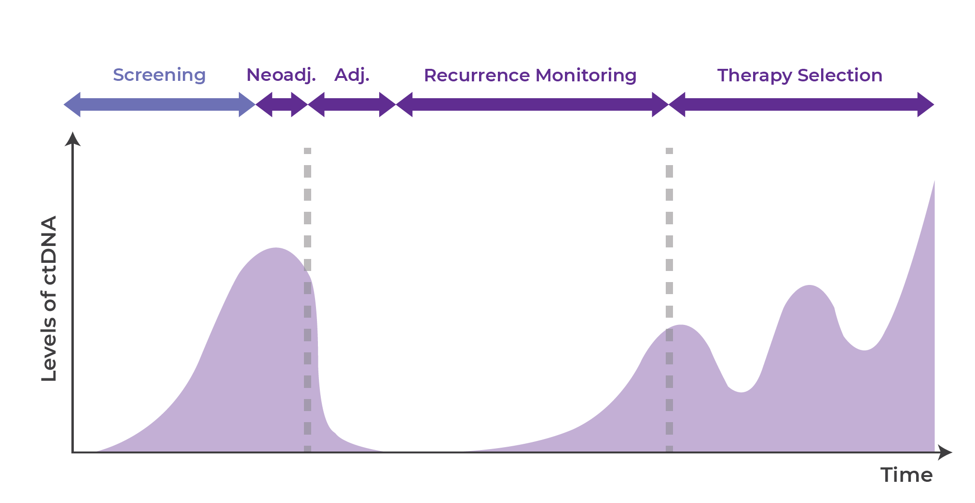
Promise and Application of Circulating Tumor-Derived Material
Serial liquid
biopsy testing
Screening or earlier diagnosis
Molecular profiling or prognostication
Detection of residual disease
Monitoring response
Monitoring evolution
MCED
Relapse
Tumor Burden
Time
Surgery (or other)
Treatment 1
Treatment 2
Treatment selection
MCED: multicancer early detection.
1. Wan JCM, et al. Nat Rev Cancer. 2017;17(4):223-238.

Slide 13
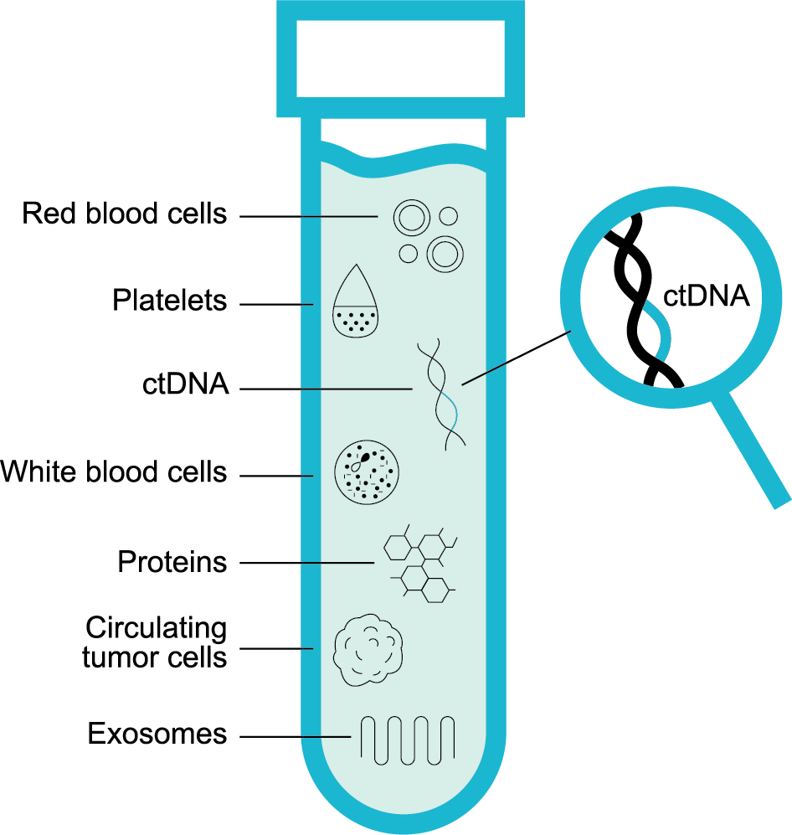
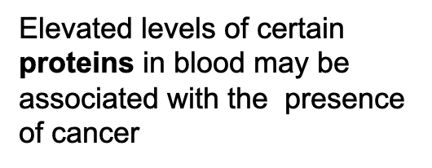
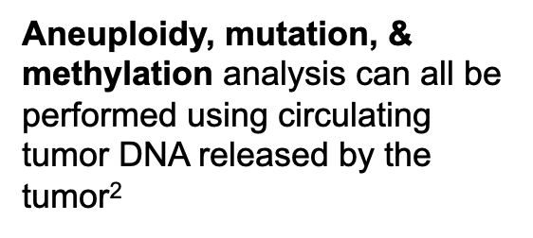
Multi-Cancer Early Detection Examines a Blood Sample for ctDNA and Other Soluble Biomarkers^{1,2}
Disclaimer: This technology is under development and the features above describe current development goals. It has not been cleared or approved by the US Food and Drug Administration (FDA) or any other national regulatory authority.
MCED: multi-cancer early detection
1. Volik S, et. al. Mol Cancer Res 2016;14(10):898–908 2. Cohen et al., Science. 2018:359(6378):926-930.

Slide 14
Multi-Cancer Early Detection Testing:
Clinical Studies

Slide 15

Development of Blood-Based Cancer Early Detection Tests
Assay development
Test development and initial validation
  Case control design
Prospective studies measured against current SOC tests
  Testing simultaneously with a standard screening procedure
  Focus on single cancer
  No return of results
Prospective studies with return of results
  Multi-cancer application
SOC: standard of care.

Slide 16
DETECT-A: The First Large, Prospective, Interventional Study Aimed to Evaluate the Diagnostic Performance of an MCED Test
Study Goals
Study Design
Enrollment
Determine the impact of MCED testing in combination with standard
of care
Evaluate blood test and diagnostic work-up in a large clinical population
Deliver test results to inform patient care
Blood test
Review by
multidisciplinary committee
Imaging of blood test
positive cases
(PET + IV contrast CT)
Follow-up Survey (1 year)
10,006 women enrolled
(9911 screened)
Aged between 65-75
September 2017 – May 2019
Only exclusion criteria:
No prior history of cancer
Disclaimer: This technology is under development and the features above describe current development goals. It has not been cleared or approved by the US Food and Drug Administration (FDA) or any other national regulatory authority.
MCED: multi-cancer early detection. PET: positron emission tomography; IV: intravenous; CT: computed tomography
Lennon AM, et al. Science. 2020;369(6499):eabb9601.

Slide 17
MCED Test Performance Outcomes from DETECT-A Study
Calculated in the basis of a one-year follow-up
Metric | Specifications | DETECT-A Results
Sensitivity TP/(TP+FN) | Cancers found by CancerSEEK alone | 27.1% 26/(26+70)
 | Cancer found by CancerSEEK or SOC screening | 52.1% 50/(50+46)
Specificity TN/(TN+FP) | CancerSEEK + PET-CT | 99.6% 9777/(9777+38)
 | CancerSEEK alone | 98.9% 9707/(9707+108)
Positive Predictive Value (PPV) TP/(TP+FP) | CancerSEEK + any form of imaging | 40.6% 26/(26+38)
 | CancerSEEK alone | 19.4% 26/(26+108)
Disclaimer: This technology is under development and the features above describe current development goals. It has not been cleared or approved by the US Food and Drug Administration (FDA) or any other national regulatory authority.
TP: true positive; TN: true negative; FP: false positive; FN: false negative; PET: positron emission tomography; IV: intravenous; CT: computed tomography
Lennon AM, et al. Science. 2020;369(6499):eabb9601.

Slide 18
Results of the First Prospective Interventional Study: DETECT-A^{1,2}
MCED testing doubled the number of cases first
detected by screening
Majority of cancers detected by the MCED test were earlier stage
65%
of cancers† detected
were
localized
or regional disease
(Stage I-III)
24 → 50
Cancer cases detected through screening by adding an MCED blood test
Disclaimer: This technology is under development and the features above describe current development goals. It has not been cleared or approved by the US Food and Drug Administration (FDA) or any other national regulatory authority
*The TNM staging for the Appendix carcinoma was not available at the time of the original DETECT-A publication. Stage distribution has been updated. †17 of 26 cancers first detected by blood testing were classified as localized or regional disease.
MCED: multi-cancer early detection.
1. Lennon AM, et al. Science. 2020;369(6499):eabb9601. 2. Buchanan AH, et al. Long-term clinical outcomes diagnosed following detection by a blood-based multi-cancer early detection (MCED) test. Presented on June 3, 2023, at the ASCO Annual Meeting in Chicago, IL.

Slide 19
DETECT-A: Cancers Detected in 9 Organ Sites- 6 Have No Recommended Screening Options
 |  | First Detected by Blood Testing |  |  |  |  | First Detected by SOC Screening |  |  |  |  | First Detected by Other Means
Thyroid |  | 1 |  |  |  |  |  |  |  |  |  | 1 | 2 |  | 1
Sarcoma |  |  |  |  |  |  |  |  |  |  |  | 1 |  | 1
Lymphoma |  |  |  | 2 |  |  |  |  |  |  |  | 2
Uterine |  | 2 |  |  |  |  |  |  |  |  |  | 11 |  | 2
Ovary |  | 1 |  | 1 | 4 |  |  |  |  |  |  | 1
Bile Duct |  |  |  |  |  |  |  |  |  |  |  |  |  |  | 1
Pancreatic Neuroendocrine |  |  |  |  |  |  |  |  |  |  |  | 1 | 1
Liver |  |  |  |  |  |  |  |  |  |  |  |  |  |  | 1
Kidney |  |  |  | 1 |  |  |  |  |  |  |  | 1
Bladder |  |  |  |  |  |  |  |  |  |  |  |  |  |  | 1
Stomach |  |  |  |  |  |  |  |  |  |  |  | 2 |  | 1
Appendix* |  |  | 1
Breast |  |  |  | 1 |  |  | 16 | 4 |  |  |  | 3 | 2 |  | 1
Colorectal |  |  | 1 | 1 |  |  | 1
Lung† |  | 1 | 2 | 2 | 5 |  | 1 |  |  | 2 |  | 3 | 2 | 1 | 3
Type, stage, and detection modality for cancer identified in the DETECT-A study
All cancers identified in the study during the 12-month post-enrollment period were stratified by how they were detected, by site of origin, then by stage.
Primary cancer organ
I II III IV
I II III IV
I II III IV
Stage
Disclaimer: This technology is under development and the features above describe current development goals. It has not been cleared or approved by the US Food and Drug Administration (FDA) or any other national regulatory authority
*TNM staging for the Appendix carcinoma was not available at the time of the original DETECT-A publication. Stage distribution has been updated
†Includes carcinoma of unknown primary origin that was noted as possibly being small cell lung cancer.
SOC: Standard of care.
1. Adapted from Lennon AM, et al. Science. 2020;369(6499)(suppl):eabb9601. 2. Buchanan AH, et al. Long-term clinical outcomes diagnosed following detection by a blood-based multi-cancer early detection (MCED) test. Presented on June 3, 2023, at the ASCO Annual Meeting in Chicago, IL.

Slide 20

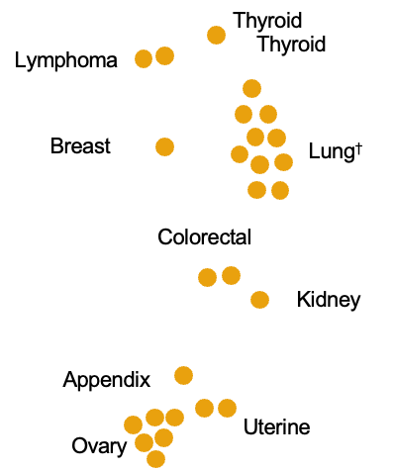
In DETECT-A, Cancers were Detected in Multiple Organs, the Majority of Which Have No Screening Options^{1,2}
Cancers first detected by blood testing
Cancer Type | Standard-of-care screening available | Detected in DETECT-A
Ovary | NO | ✓
Thyroid | NO | ✓
Lymphoma | NO | ✓
Uterine | NO | ✓
Appendix | NO | ✓
Kidney | NO | ✓
Breast | ✓ | ✓
Colorectal | ✓ | ✓
Lung | ✓*† | ✓
Disclaimer: This technology is under development and the features above describe current development goals. It has not been cleared or approved by the US Food and Drug Administration (FDA) or any other national regulatory authority.
*Low Dose CT only indicated for high-risk populations
†A carcinoma of unknown primary origin was reported in the original DETECT-A publication. It is now classified as small cell lung cancer.
1. Lennon AM, et al. Science. 2020;369(6499):eabb9601. 2. Buchanan AH, et al. Long-term clinical outcomes diagnosed following detection by a blood-based multi-cancer early detection (MCED) test. Presented on June 3, 2023, at the ASCO Annual Meeting in Chicago, IL.

Slide 21
Results from the DETECT-A Study Demonstrate the Complementary Nature of Mutation and Protein Biomarkers
Number of Times Observed in Participants with Cancer
Proportion of Cancers Detected by
Biomarker Class
Mutated Genes
Elevated Proteins
4%
(1) detected by both mutation and protein markers
TP53
PIK3CA
CA 15-3
BRAF
CEA
KRAS
CA 19-9
54%
(14) detected by
mutation markers
EGFR
HGF
42%
(11) Detected by protein markers
NRAS
CA 125
0
2
4
6
8
10
12
0
1
2
3
4
Disclaimer: This technology is under development and the features above describe current development goals. It has not been cleared or approved by the US Food and Drug Administration (FDA) or any other national regulatory authority.
Lennon AM, et al. Science. 2020;369(6499):eabb9601.

Slide 22
Exploring the Value of Multi-Analyte Analysis in MCED Testing

Slide 23


Multiple Studies Conducted to Explore the Potential to Enhance Performance with Additional Biomarkers
Methylation
Aneuploidy
Mutations
Proteins

Slide 24
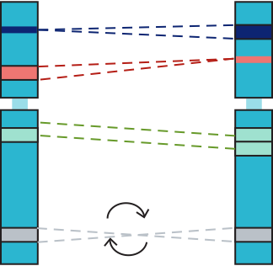
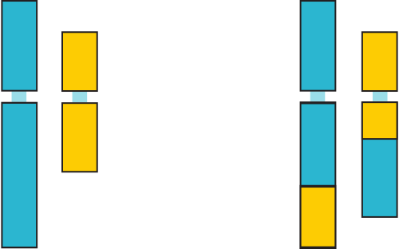
Circulating Tumor DNA (ctDNA): Copy Number Variations
Copy number changes and aneuploidy are common in cancer and carry important information related to diagnosis, prognosis, and therapeutic response¹⁻⁵
Genomic Alteration Lexicon
• Genomic aberration: Acquired changes in the tumor genome¹ • Variation: Inherited germ line differences between individuals¹
Classification based on cellular origin and degree of chromosomal change
    Copy number variant (CNV): CNAs of 1 kb to 3 Mb that occur in the germline cells. Alternatively, CNVs can be defined as a segment of DNA 1 kb or larger that is present at a variable copy number in comparison to reference genome^{1,2,6}
    Somatic copy number alteration (SCNA): CNAs arising post-zygotically in a somatic cell; two main classes of SCNAs include:^{2,3}
      Aneuploidy: Unbalanced number of chromosomes (gains or losses of entire chromosomes)^{2,3}
      Focal CNA: CNAs of limited size that include gains or losses of chromosomal arms or smaller chromosomal regions. Focal CNAs result from selection events during evolution of cancer genome and often give tumors a proliferative advantage^{1,2}
    Classification based on type of change in chromosome structure
    Structural variant: Cytogenetically detectable genomic alterations that involve segments of DNA that are larger than 1 kb and can be microscopic or submicroscopic^{6,7}
Classes of CNVs⁷
    Classification based on functional outcomes in cancer
      Driver mutation: Subset of cancer aberrations contributing to tumor initiation and progression¹
      Passenger mutation: Noncontributing aberrations not involved in cancer pathogenesis¹
Insertion
Deletion
Translocation
Duplication
Inversion
Adapted from Balachandran P, et al. 2020.
CNA: copy number aberration; CNV: copy number variation; SCNA: somatic copy number alteration.
1. Krijgsman O, et al. Biochim J. 2018;16:190-195. Biophys Acta. 2014;1843(11):2698-2704. 2. Harbers L, et al. Front Oncol. 2021;11:700568. 3. Taylor AM, et al. Cancer Cell. 2018;33(4):676-689.e3. 4. Weaver BA, Cleveland DW. Cancer Cell. 2008;14(6):431-433. 5. Kim HY, et al. Oncotarget. 2017;8(16):27277-27285. 6. Feuk L, et al. Nat Rev Genet. 2006;7(2):85-97. 7. Balachandran P, et al. Chromosome Res. 2020;28(1):31-47.

Slide 25
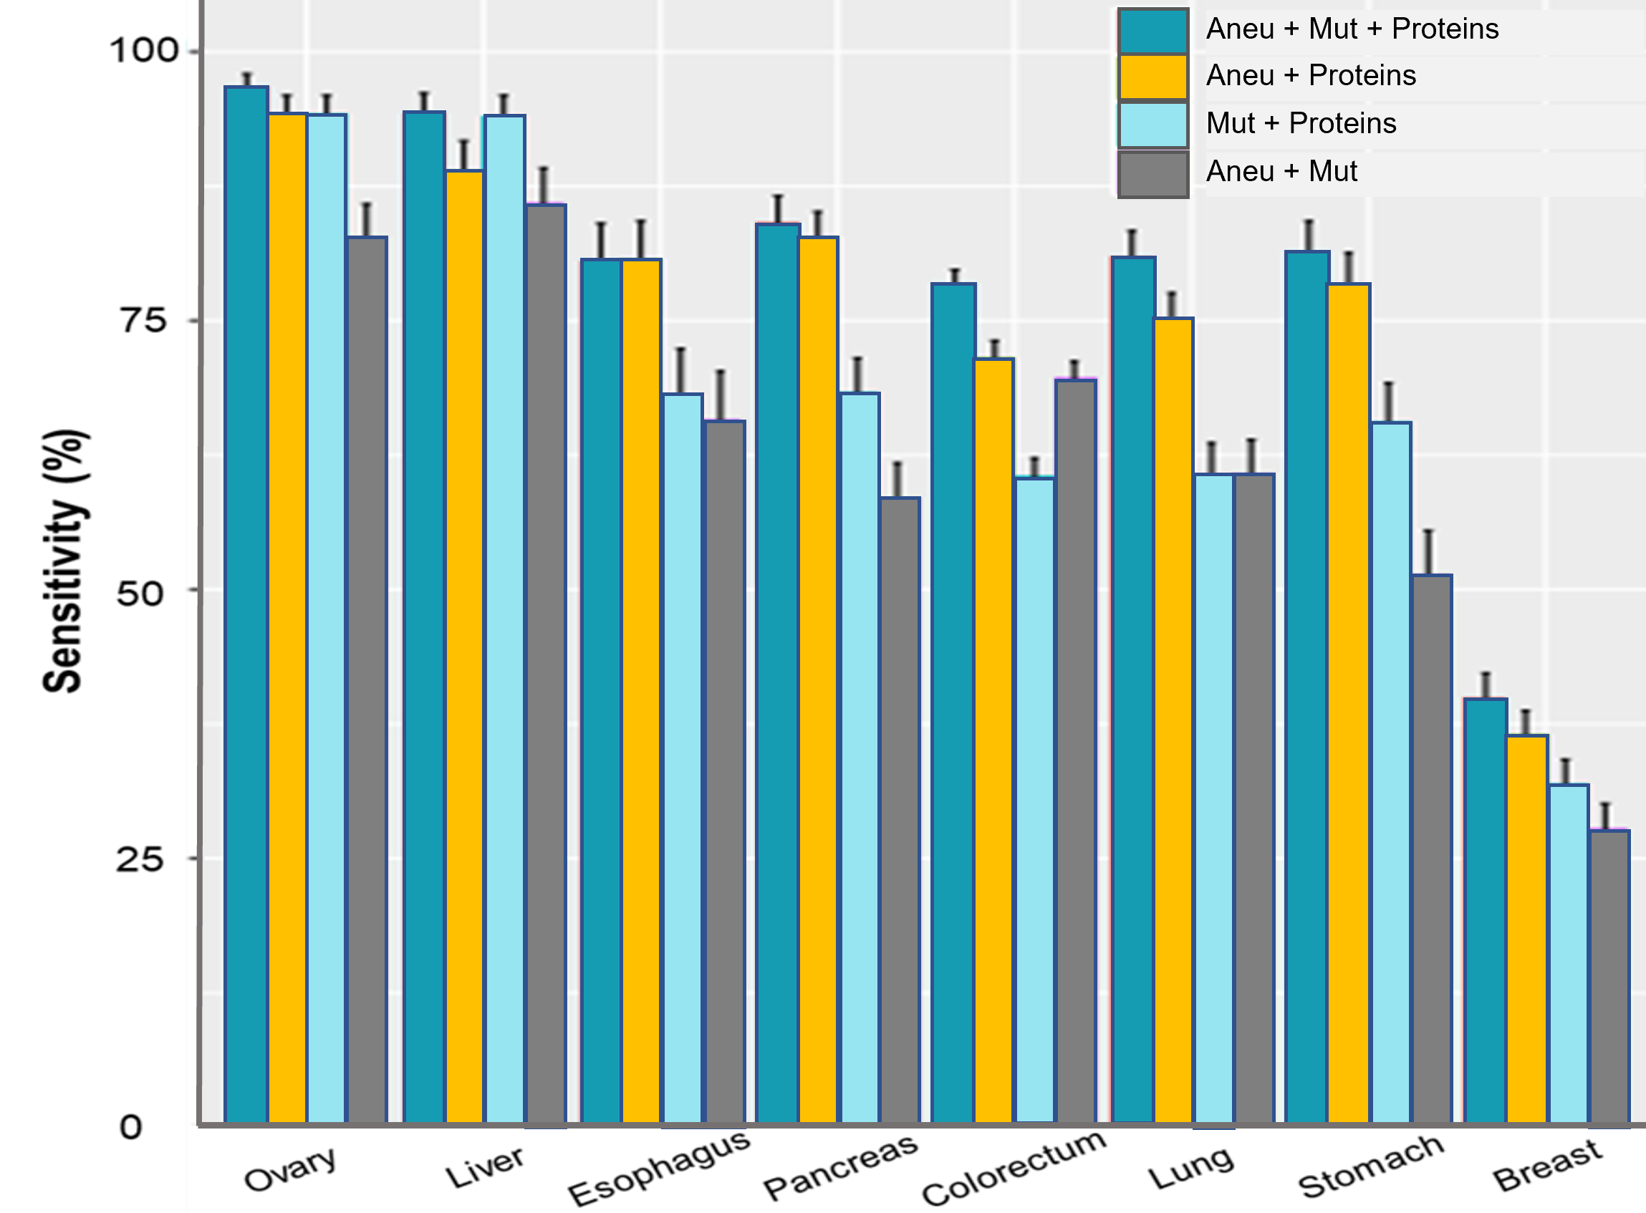
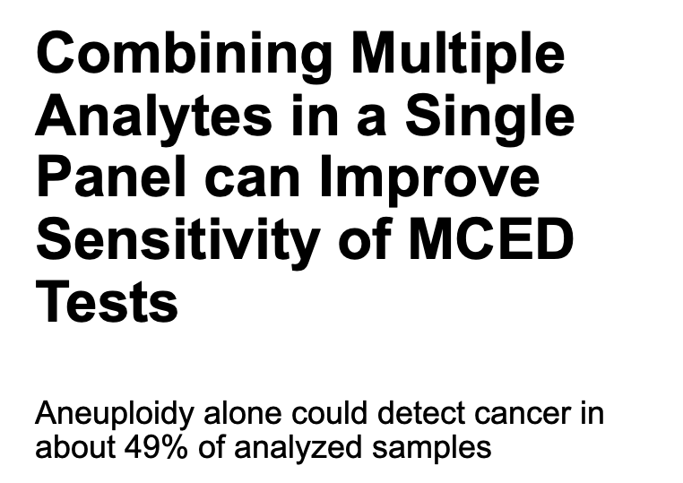
Disclaimer: This technology is under development and the features above describe current development goals. It has not been cleared or approved by the US Food and Drug Administration (FDA) or any other national regulatory authority.
Douville C, et al. Proc Natl Acad Sci. 2020;117(9):4858-4863.

Slide 26


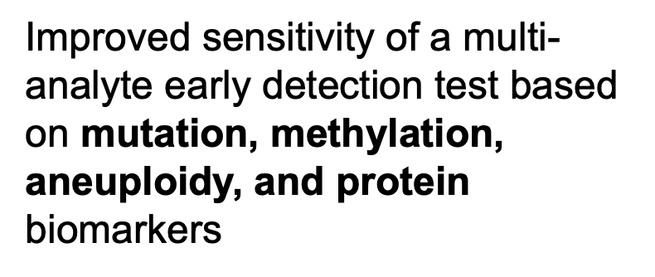
Data Presented at AACR* Special Conference 2022 Demonstrated the Power of a Multi-Biomarker Class Approach for MCED Testing
Aneuploidy
Methylation
Mutations
Proteins
Disclaimer: This technology is under development and the features above describe current development goals. It has not been cleared or approved by the US Food and Drug Administration (FDA) or any other national regulatory authority.
*American Association for Cancer Research
Gainullin V, Hagmann L, Arvai K, et al. Improved sensitivity of a multi-analyte early detection test based on mutation, methylation, aneuploidy, and protein biomarkers. Presented at AACR Special Conference: Precision, Prevention, Early Detection, and Interception of Cancer in Austin, TX on November 18, 2022.

Slide 27

Case Control Study Design—3 and 4 Biomarker Class Test Designs Evaluated for Cancer Detection of 15 Cancer Sites
4196
2948 non-cancers (including 532 non-cancer disease samples)
Total cohort
1248 cancers
Initial sample set: 1296
Excluded from analysis:
36 | QC
31 | Cirrhosis without cancer
Analyzed sample set: 1259
649 | Cancer (incl. 28 w/cirrhosis)
610 | Non-cancer
  121 benign tumor*
  489 no cancer suspected
Training & Validation Set
Initial sample set: 2900
Excluded from analysis:
165 | QC
349 | Cirrhosis
Analyzed sample set: 2386
565 | Cancer
1821 | Non-cancer
Test Set
Training & Validation by
5-fold cross validation
Combined performance
OR-logic & Logistic Regression
Models & Thresholds
4 Markers
Aneuploidy
Methylation
Proteins
Mutations
3 Markers
Aneuploidy
Methylation
Proteins
Disclaimer: This technology is under development and the features above describe current development goals. It has not been cleared or approved by the US Food and Drug Administration (FDA) or any other national regulatory authority.
*Tumor was identified, biopsied, and returned from histopathology with a benign reading.
QC: quality control.
Gainullin V, et al. Improved sensitivity of a multi-analyte early detection test based on mutation, methylation, aneuploidy, and protein biomarkers. Presented at AACR Special Conference: Precision, Prevention, Early Detection, and Interception of Cancer on November 18, 2022, in Austin, TX..

Slide 28

Test Set Performance—Sensitivity Increased to >62% with Addition of Somatic Mutations
1259 analyzed samples
Detected cancer in
Detected
all
all
organ sites tested
cancer stages tested
Three biomarker class design:
Aneuploidy | Methylation | Proteins
Four biomarker class design:
Aneuploidy | Methylation | Proteins | Mutations
55.2%
62.4%
Overall sensitivity
Overall sensitivity
95% CI: 51.3%-59.0%
95% CI: 58.7%-66.1%
99.0%
98.0%
Specificity
Specificity
95% CI: 98.2%-99.8%
95% CI: 96.9%-99.1%
Disclaimer: This technology is under development and the features above describe current development goals. It has not been cleared or approved by the US Food and Drug Administration (FDA) or any other national regulatory authority.
Gainullin V, Hagmann L, Arvai K, et al. Improved sensitivity of a multi-analyte early detection test based on mutation, methylation, aneuploidy, and protein biomarkers. Presented at AACR Special Conference: Precision, Prevention, Early Detection, and Interception of Cancer in Austin, TX on November 18, 2022.

Slide 29
The 4-Biomarker Class Approach with a Machine Learning Classifier Improved Early-Stage Sensitivity
3-biomarker class test design
Stage I - III
4 marker class panel³
Sensitivity: 53.1%
+6.8% vs. 3 marker class panel³
4-biomarker class test design
Performance demonstrates the potential to improve early-stage cancer detection¹ when cancer is more treatable²
+4.2%
Stage I + II
4 marker class panel³
Sensitivity: 40.5%
+8.9% vs. 3 marker class panel³
+6.8%
Notable
stage I and II sensitivity with the a 4-biomarker class panel³
Sensitivity %
+5.1%
8.9%
average increase in sensitivity for stage I/II ³
+12.9%
17.4
17.4
Disclaimer: This technology is under development and the features above describe current development goals. It has not been cleared or approved by the US Food and Drug Administration (FDA) or any other national regulatory authority.
1. Gainullin V, Hagmann L, Arvai K, et al. Improved sensitivity of a multi-analyte early detection test based on mutation, methylation, aneuploidy, and protein biomarkers. Presented at AACR Special Conference: Precision, Prevention, Early Detection, and Interception of Cancer in Austin, TX on November 18, 2022. 2. Siegel RL, Miller KD, Wagel NS, Jemal A. Cancer statistics, 2023. CA Cancer J Clin. 2023;73:17-48. 3. Internal Data on File. Exact Sciences Corporation. Madison, WI

Slide 30




Next Step in EXACT SCIENCES Multi-Biomarker Class MCED Test Development
INITIATE
Pivotal Study
Prospective, interventional, longitudinal trial
Complete
ASCEND-2
Classifier validation study and final selection of test components
Initiate
pivotal trial
Prospective, interventional, longitudinal trial
Collaborate
NCI, advocacy groups, and policy makers
Collaborate
NCI, advocacy groups, and policy makers
COLLABORATE
FINALIZE
NCI, advocacy groups, investigators, and policy makers
Classifier validation and selection of test components
Disclaimer: This technology is under development and the features above describe current development goals. It has not been cleared or approved by the US Food and Drug Administration (FDA) or any other national regulatory authority.

Slide 31







Anticipating and Addressing Potential Risks of MCED Testing is Key to Helping Realize its Benefits
Forgo SOC Screening
Exacerbate disparities
Clear path to diagnostic resolution
Increase patient anxiety
Over diagnosis and treatment
Unnecessary procedures due to false positive results
Cost to society/healthcare system
MCED: multi-cancer early detection; SOC: standard of care.

Slide 32
These slides are provided for educational purposes as of April 18, 2024
Note:
These slides are made available to any appropriately requesting individual, regardless of the manner in which they cover, recommend, or participate in the ordering of any Exact Sciences product.
Individuals may use these slides for scientific or educational purposes only.
Exact Sciences does not grant permission to modify the slides or their content and therefore is not responsible for any edits or changes made by a user. This includes, but not limited to, edits or changes to the contents, order, format, and/or incorporation or adoption of these slides or their content into other materials.
The information on these slides may not constitute the most up-to-date data information or data. It is the user’s responsibility to verify the accuracy of these slides for the desired use to comply with applicable rules, laws, or regulations (e.g., event organizer or accrediting body standards/requirements, copyright laws, institutional requirements, etc.).
These slides and their contents are provided: (1) with any faults AS IS AND AS AVAILABLE; and (2) without any assurance, warranty, condition, or duty of or regarding the slides and/or their contents: accuracy, availability, adequacy, validity, reliability, completeness, performance, or compatibility. Exact Sciences disclaims any liability associated with the use of these slides.
© 2023 Exact Sciences Corporation. All rights reserved.

