Slide 1
These Slides are Provided for Educational Purposes as of April 2025.
Note:
These slides are made available to any appropriately requesting individual, regardless of the manner in which they cover, recommend, or participate in the ordering of any Exact Sciences product.
Individuals may use these slides for scientific or educational purposes only.
Exact Sciences does not grant permission to modify the slides or their content and therefore is not responsible for any edits or changes made by a user. This includes, but not limited to, edits or changes to the contents, order, format, and/or incorporation or adoption of these slides or their content into other materials.
The information on these slides may not constitute the most up-to-date data information or data. It is the user’s responsibility to verify the accuracy of these slides for the desired use to comply with applicable rules, laws, or regulations (e.g., event organizer or accrediting body standards/requirements, copyright laws, institutional requirements, etc.).
These slides and their contents are provided: (1) with any faults AS IS AND AS AVAILABLE; and (2) without any assurance, warranty, condition, or duty of or regarding the slides and/or their contents: accuracy, availability, adequacy, validity, reliability, completeness, performance, or compatibility. Exact Sciences disclaims any liability associated with the use of these slides.

Slide 2
Cologuard PlusTM Test Performance
BLUE-C Study
Cologuard Plus is a trademark of Exact Sciences Corporation. All other trademarks are properties of their respective owners.
© 2025 Exact Sciences Corporation. All rights reserved.
April 2025 / MED-CG2400071 (v4.0)

Slide 3
BLUE-C Study Design
BLUE-C was a prospective, cross-sectional study (N=20,176) that assessed the sensitivity for CRC and specificity for advanced neoplasia using colonoscopy as the reference standard.^{1,2}
Participants (N=18,911) for the FDA-approved label were average risk, asymptomatic adults 45-86 with no first-degree relative with CRC.²
Participants¹
Study Design^{1,3}
Outcomes¹
        Key inclusion criteria
        Asymptomatic adults ≥40 years of age
        Scheduled for screening colonoscopy
        Key exclusion criteria
        Personal history of CRC or APLs
        Medical/Family history of hereditary CRC syndromes
        Inflammatory bowel disease or Cronkhite–Canada syndrome
        A positive result for the Cologuard® test within 2 years or positive FIT or fecal occult blood test within 6 months
        Colonoscopy within 9 years
        Rectal bleeding within 30 days
        Primary outcomes
        Sensitivity for CRC
        Specificity for advanced neoplasia (i.e., CRC or APLs†)
        Secondary outcomes
        Sensitivity for APLs †
        Comparison of sensitivity for CRC and APLs† between the next-generation mt-sDNA test and commercial FIT*
        Specificity for non-neoplastic findings or negative colonoscopy
Laboratory performed
the mt-sDNA test (including hemoglobin component) and a separate FIT* on each stool sample
Participants provided a
single stool and blood sample
Participants also underwent screening colonoscopy (reference standard)
*Polymedco OC-Auto® Micro 80 iFOB Test; positivity cutoff: hemoglobin >100 ng/mL.
†Adenomas with high-grade dysplasia/carcinoma in situ of any size; adenomas with villous growth pattern (≥25%) of any size; adenomas ≥10 mm; serrated lesions ≥10 mm; or hyperplastic polyps ≥10 mm.

Slide 4
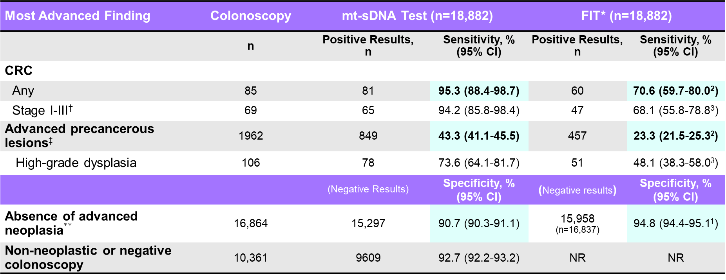
Sensitivity and Specificity of the Cologuard PlusTM Test vs FIT^{1-3*}
Most Advanced Finding | Colonoscopy | mt-sDNA Test (n=18,882) |  | FIT* (n=18,882)
 | n | Positive Results, n | Sensitivity, % (95% CI) | Positive Results, n | Sensitivity, % (95% CI)
CRC
Any | 85 | 81 | 95.3 (88.4-98.7) | 60 | 70.6 (59.7-80.0²)
Stage I-III† | 69 | 65 | 94.2 (85.8-98.4) | 47 | 68.1 (55.8-78.8³)
Advanced precancerous lesions‡ | 1962 | 849 | 43.3 (41.1-45.5) | 457 | 23.3 (21.5-25.3²)
High-grade dysplasia | 106 | 78 | 73.6 (64.1-81.7) | 51 | 48.1 (38.3-58.0³)
 |  | (Negative Results) | Specificity, % (95% CI) | (Negative results) | Specificity, % (95% CI)
Absence of advanced neoplasia$∗∗$ | 16,864 | 15,297 | 90.7 (90.3-91.1) | 15,958 (n=16,837) | 94.8 (94.4-95.1¹)
Non-neoplastic or negative colonoscopy | 10,361 | 9609 | 92.7 (92.2-93.2) | NR | NR
Age-weighted to the US Population Specificity: 94% (95% CI, 93.2-94.5).

Slide 5
Sensitivity of the Cologuard PlusTM Test and FIT,* According to Subgroup
CRC According to Stage‡
CRC and Advanced Precancerous Lesions§
According to Location
Higher-Risk Types Among Advanced
Precancerous Lesions
Advanced Precancerous Lesions According to
Size of Largest Lesion
Cologuard Plus FIT
*Polymedco OC-Auto® Micro 80 iFOB Test; positivity cutoff: hemoglobin >100 ng/mL.
†SSLD defined as sessile serrated lesion with dysplasia, traditional serrated adenoma, conventional adenoma with serrated architecture, sessile serrated lesion ≥10mm. ‡These stages of CRC, as defined by the AJCC, are associated with an
increased rate of cure. §†Advanced precancerous lesions: high-grade dysplasia; greater ≥10 adenomas, any size; tubulovillous adenoma, any size; tubular adenoma ≥10 mm; sessile serrate lesion with dysplasia; traditional serrated adenoma;
conventional adenoma with serrated architecture; sessile serrated lesion ≥10 mm.
CRC: colorectal cancer; FIT: fecal immunochemical test.
Cologuard Plus Clinician Brochure. Exact Sciences Corporation. Madiosn, WI

Slide 6
CRC Sensitivity of the Cologuard PlusTM Test and FIT,* According to Stage
*Polymedco OC-Auto® Micro 80 iFOB Test; positivity cutoff: hemoglobin >100 ng/mL..
CRC: colorectal cancer; FIT: fecal immunochemical test;.
Cologuard Plus Clinician Brochure. Exact Sciences Corporation. Madiosn, WI.

Slide 7
CRC and APL Sensitivity of the Cologuard PlusTM Test and FIT,* According to Location
*Polymedco OC-Auto® Micro 80 iFOB Test; positivity cutoff: hemoglobin >100 ng/mL.
CRC: colorectal cancer; FIT: fecal immunochemical test. APL: Advanced precancerous lesions: high-grade dysplasia greater ≥10 adenomas, any size; tubulovillous adenoma, any size; tubular adenoma ≥10 mm; sessile serrated lesion with dysplasia; traditional serrated adenoma; conventional adenoma with serrated architecture; sessile serrated lesion ≥10 mm.
Cologuard Plus Clinician Brochure. Exact Sciences Corporation. Madiosn, WI.

Slide 8
CRC Sensitivity of the Cologuard PlusTM Test and FIT,* According to Size
*Polymedco OC-Auto® Micro 80 iFOB Test; positivity cutoff: hemoglobin >100 ng/mL.
CRC: colorectal cancer; FIT: fecal immunochemical test; mm: millimeter.
Cologuard Plus Clinician Brochure. Exact Sciences Corporation. Madiosn, WI.

Slide 9


The Cologuard PlusTM Test Performance† for Patients Aged 45-59 Years
100% Sensitivity % (n/N)
Most advanced colonoscopy finding (index lesion)
CRC, Stages I to IV
(20/20)
94% Specificity* % (n/N)
Absence of Advanced Neoplasia
(5419/5788)
†Calculations based on the summation of data from ages 45-59.
*Specificity includes Categories 3-6.
Cologuard Plus Clinician Brochure. Exact Sciences Corporation. Madison, WI.

Slide 10
Interpreting the Cologuard PlusTM Test Results
POSITIVE Cologuard Plus
Test Results*
NEGATIVE Cologuard Plus
Test Results
13% (n=2497)
87% (n=16,414)
3.2% (n=81)
0.02% (n=4)
6.8% (n=1113)
7 of 10 (70%) persons with a POSITIVE
mt-sDNA
result would have an actionable finding on colonoscopy
2 of 10,000 persons with a NEGATIVE
mt-sDNA result would have CRC on colonoscopy
30.1%
(n=752)
58.5%
(n=9609)
34.7%
(n=5688)
32.6%
(n=815)
28.6%
(n=2398)
45.4%
(n=732)
66.1%
(n=5549)
30.9%
(n=498)
Colonoscopy Results
Colonoscopy Results
CRC
Advanced precancerous lesions†
Nonadvanced adenoma
(Category 3-5)
Negative/no findings
(Category 6)

Slide 11
Validation of the
Next-Generation mt-sDNA Test

Slide 12
Clinical Studies and Development Process for the Next-Generation mt-sDNA Biomarker Panel
Flow of Studies in the Development of the
Next-generation mt-sDNA Test*
Process Graphic for Flow of Marker Selection and
Verification Studies†
Discovery and independent testing
Phase I—Initial Marker Selection Study
 | Archived Samples
Purpose: Identify high-performing markers for novel mt-sDNA panel Markers: 12 MDMs, Hb, ZDHHC1 (reference) | Case | CRC | 120
 |  | APL | 112
 | Control | Non-APL | 163
 |  | Negative | 327
Pilot/Feasibility in stool
Marker selection and verification in stool
Marker elimination (12 MDMs to 3 MDMs)
Assay optimization (DNA capture, bisulfite conversion, DNA assays)
Algorithm development and early performance evaluation
Phase II—Verification study
 | Samples
Purpose: Determine novel mt-sDNA panel performance Markers: 3 MDMs, Hb, ZDHHC1 (reference) Emphasized small lesion size to better assess early detection | Case | CRC | 112
 |  | APL‡ | 98
 | Control | Non-APL‡ | 176
 |  | Negative‡ | 391
Prospective clinical validation of next-generation mt-sDNA test

Slide 13
Validation Of Novel Biomarkers
To assess novel biomarkers in the next-generation mt-sDNA test and enhance its clinical performance, an improved algorithm was trained, tested, and validated
Algorithm development
Development: New optimized biomarker panel, algorithm, and clinical decision cutoff values
Novel biomarkers: Methylated DNA markers (MDMs) and a reference MDM (ZDHHC1) and hemoglobin
Training set: 3011 samples from 2 CRC screening studies (Act Bold and Act Fast)
Performance evaluation/
validation with DeeP-C samples
Validation: The next-generation mt-sDNA test performance was evaluated against archived DeeP-C samples
Testing set: An independent sample from 7662 participants (DeeP-C study, 2011-2013)
  640 participants had CRC (n=57) or APLs (n=583)
  7022 were negative for advanced neoplasia (CRC or APL)
Primary endpoints: CRC sensitivity and specificity for the absence of advanced neoplasia (non-advanced adenomas, non-neoplastic findings, and negative colonoscopy)
Secondary endpoints: Sensitivity for APLs and specificity for non-neoplastic findings or negative colonoscopy

Slide 14
Performance Validation of the Next-Generation mt-sDNA Test
The performance estimates of the next-generation mt-sDNA test remained consistent with historical outcomes among individuals at average risk for CRC
%
%
%
%
%
%
%
%
%
%
%
%
(n=583) (n=4) (n=6) (n=21) (n=25) (n=57)
(n=7022) (n=4859)
The Next-Generation mt-sDNA test
This study confirmed the reproducibility and established the clinically relevant performance features for the next-generation mt-sDNA test.

Slide 15
Sensitivity of the Next-Generation mt-sDNA Test for Advanced Precancerous Lesions (APLs)
The next-generation mt-sDNA test has demonstrated high sensitivity for detecting APLs
%
%
%
%
%
%
%
%
%
%
%
%
Lesion size, mm
(n=51) (n=441) (n=60) (n=31)
(n=30)
(n=75)
The Next-Generation mt-sDNA test
Among APL subgroups, the next-generation mt-sDNA test sensitivity was highest for adenomas with high-grade dysplasia, and sensitivity increased for larger lesion size.

Slide 16

Study Limitations
CRC positive samples used in the algorithm training were collected post colonoscopy, of which 41.4% (41 of 99 valid CRC samples) were collected from symptomatic patients. These cases may not represent the spectrum of CRC from an average-risk CRC screening population
The DeeP-C stool samples were collected >10 years prior to the current analysis, and only a subset was available for evaluation
Using the same sample set to evaluate both the first- and next-generation test meant that overall type 1 error is no longer controlled across all hypothesis testing. This can lead to false positive results or erroneously suggest there was a significant difference when there was not
Racial/ethnic diversity was limited for both the training set and test set samples
This algorithm study was not a head-to-head comparison of the first-generation and the next-generation mt-sDNA tests but rather an internal cross-validation of the novel biomarker panel and algorithm with DeeP-C study samples. Performance parameters should be evaluated with this in mind

Slide 17

Summary
Met study goals: The study indicated that the updated biomarkers met objectives through higher specificity with the goal of reducing false positives compared to the first-generation Cologuard® test.
Optimized biomarker panel and reproducibility of results: The strength of the next-generation mt-sDNA test was improved through the pursuit of novel CRC-associated biomarkers. The next-generation mt-sDNA test confirmed the reproducibility and established the clinically relevant performance features
Validated algorithm: The next-generation mt-sDNA test algorithm and associated cut-off value were locked before this validation study was undertaken, reinforcing the robustness of these outcome data and their applicability to a similar real-world population

Slide 18
Next-Generation Multitarget Stool DNA Test for Colorectal Cancer Screening (BLUE-C Study)

Slide 19






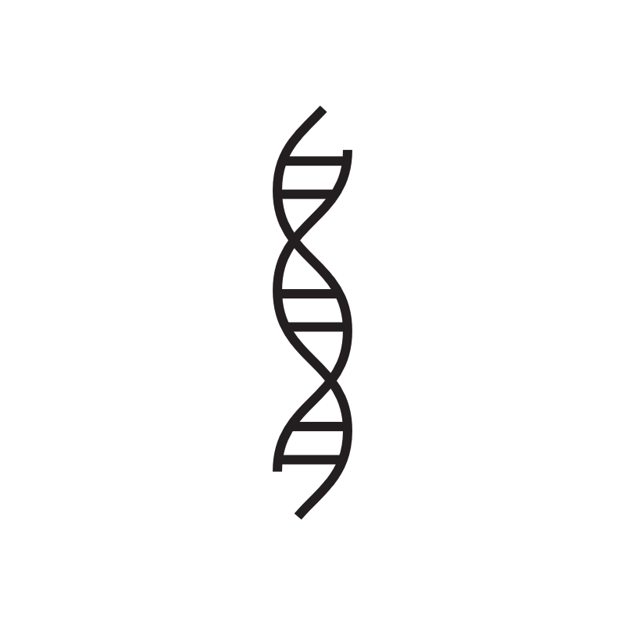


BLUE-C Study Flow¹
The next-generation mt-sDNA collection kit
26,758 participants enrolled at 186 sites, 20,176 evaluable samples²
Positive results for any CRC²:
Colonoscopy: 98
The next-generation mt-sDNA test: 92
FIT: 66
Stool sample
Commercial FIT*
Fecal hemoglobin processing
Whole stool sample processing for biomarkers
Stool sample for Hb by commercial FIT
Stool sample for Hb
Whole stool sample for MDM
Buffer adjusted, homogenized → -80°C
Molecular Pathology Laboratory Network, Knoxville, TN²
Exact Sciences Laboratories, Madison, WI
Centrifuged, removed PCR inhibitors, captured magnetic beads of MDM
Vortexed → -80°C
ELISA
3 MDMs and a reference standard
Exact Sciences System Software
Bisulfite conversion
Qualitative analytic result†
Analytic result fecal hemoglobin
Analytic quantification of MDMs
Quantitative amplification: LQAS
x₁
x₂
x₃
x₄
x₅
Biomarker or Hb
w₁
w₂
w₃
w₄
w₅
Weighting factors
Positive
Negative
Logistic regression algorithm‡
Positive
Negative
ELISA: enzyme-linked immunosorbent assay; FIT: fecal immunochemical test; Hb: hemoglobin; LQAS: long-probe quantitative amplified signal; MDM: methylated DNA marker; PCR: polymerase chain reaction.
1. Imperiale TF, et al. N Engl J Med. 2024;390(Suppl):S1-S46. 2. Imperiale TF, et al. N Engl J Med. 2024;390(11):984-993.

Slide 20
BLUE-C: Characteristics of Study Participants
26,758 participants enrolled¹
  91.5% (24,477) had usable samples
    99.5% (24,354) had valid results
  75.4% (20,176) were valid for full evaluation
Common reasons for exclusion¹:
  Failure to complete colonoscopy: 8.3% (2218)
  Stool sample not usable per protocol: 3.2% (851)
  Stool sample not received: 3.1% (832)
Evaluable samples included (N=20,176)¹:
  CRC: 0.5% (98)
  APLs: 10.6% (2144)
  Nonadvanced adenomas: 34.6% (6973)
  Nonneoplastic findings: 17.1% (3451)
  Negative colonoscopy: 37.2% (7510)
Characteristic² | Evaluable Participants (N=20,176)*
Mean age (SD), years | 63.0 (7.3)
Sex, %
Female | 53.2
Male | 46.8
Race/Ethnicity, %
White, not Hispanic or Latino | 60.1
Hispanic or Latino | 16.3
Black, not Hispanic or Latino | 13.3
Asian, not Hispanic or Latino | 8.7
First-degree relative with family history of CRC, % | 5.2
BLUE-C enrolled more than 26,000 adults (>40 years old), with demographics representative of today’s US population.^{1,3}

Slide 21
How Did the Next-Generation mt-sDNA Test Data Compare to FIT in the BLUE-C Study?
Sensitivity of the Next-generation mt-sDNA Test vs FIT*
Specificity of the Next-generation mt-sDNA Test vs FIT*
P<0.001
P<0.001
(n=17,934)
The next-generation mt-sDNA test
FIT*
(n=10,961)
The next-generation mt-sDNA test was more sensitive than FIT* in detecting CRC; both had high specificity.

Slide 22
How Did the Next-Generation mt-sDNA Test Data Compare to FIT* in the BLUE-C Study?
Sensitivity of the Next-generation mt-sDNA Test vs FIT*
P<0.001
The next-generation mt-sDNA test
FIT*
The next-generation mt-sDNA test detected both APLs and APLs with high-grade dysplasia with higher sensitivity than FIT.*

Slide 23
How Did the Next-Generation mt-sDNA Test Data Compare to FIT* in the BLUE-C Study?^{1,2}
Sensitivity of the Next-generation mt-sDNA Test
vs FIT* for Stage I-III CRC
Sensitivity of the Next-generation mt-sDNA Test
vs FIT* by CRC Stage†
‡
The next-generation mt-sDNA test
FIT*
The next-generation mt-sDNA test was more sensitive than FIT* at detecting CRC at earlier stages (I-III).¹

Slide 24
BLUE-C: Key Takeaways
Summary
The next-generation mt-sDNA test showed significantly greater sensitivity for CRC and APLs compared with FIT*
The next-generation mt-sDNA test demonstrated high sensitivity for CRC (93.9%) and specificity for advanced neoplasia (90.6%)
Clinical Relevance
For our patients, 91% specificity means greater confidence in their test results

Slide 25
How Did the Next-Generation mt-sDNA Test Data Compare to FIT* in the BLUE-C Study?
Specificity of the Next-generation mt-sDNA Test by Age Group
Advanced Neoplasia¹
Non-neoplastic Findings or Negative Colonoscopy¹
%
%
%
%
%
%
%
%
%
%
%
%
%
%
(n=58) (n=300) (n=1475) (n=4340) (n=3338) (n=5128) (n=2613) (n=682)
(n=43) (n=216) (n=1003) (n=2681) (n=2028) (n=3055) (n=1557) (n=378)
The next-generation mt-sDNA test
FIT*
Specificity of the next-generation mt-sDNA test and FIT was equivalent for younger patients (45-49 and 50-64), which is meaningful as younger patients may be more likely to seek stool-based screening.^{1,2}

Slide 26

BLUE-C: Limitations
A relatively high proportion of individuals consented and enrolled but were not evaluable per protocol. The COVID-19 pandemic was a likely contributor, affecting both enrollment and access to colonoscopy
The results from this study should not be directly compared with published findings for the on-market Cologuard® test; valid comparisons require assessment of both tests on the same individuals and specimens concurrently in the screening setting

Slide 27

Summary
The next-generation mt-sDNA test¹
Is intended to screen those who are 45+ at average risk for CRC
Was designed to optimize CRC screening performance using novel DNA markers and fecal hemoglobin
Demonstrated 94% sensitivity for CRC and 91% specificity for advanced neoplasia
Specificity was 93% for non-neoplastic findings or negative colonoscopy* and 93% for negative colonoscopy†
In comparison with FIT‡, the next-generation mt-sDNA test showed¹
Higher sensitivity for CRC stage I-III (93% vs 65% FIT), APL (43% vs 23% FIT), and HGD
(75% vs 47% FIT); specificity was higher for FIT
Demonstrated higher sensitivity for clinically significant APLs: 75% for high-grade dysplasia, 49% for sessile-serrated polyps ≥1 cm, and 69% for lesions ≥2 cm
The next-generation mt-sDNA test PMA (premarket approval) was approved by the FDA on October 3, 2024²

Slide 28
These Slides are Provided for Educational Purposes as of April 2025.
Note:
These slides are made available to any appropriately requesting individual, regardless of the manner in which they cover, recommend, or participate in the ordering of any Exact Sciences product.
Individuals may use these slides for scientific or educational purposes only.
Exact Sciences does not grant permission to modify the slides or their content and therefore is not responsible for any edits or changes made by a user. This includes, but not limited to, edits or changes to the contents, order, format, and/or incorporation or adoption of these slides or their content into other materials.
The information on these slides may not constitute the most up-to-date data information or data. It is the user’s responsibility to verify the accuracy of these slides for the desired use to comply with applicable rules, laws, or regulations (e.g., event organizer or accrediting body standards/requirements, copyright laws, institutional requirements, etc.).
These slides and their contents are provided: (1) with any faults AS IS AND AS AVAILABLE; and (2) without any assurance, warranty, condition, or duty of or regarding the slides and/or their contents: accuracy, availability, adequacy, validity, reliability, completeness, performance, or compatibility. Exact Sciences disclaims any liability associated with the use of these slides.

